Slide 1
Algorithm Demos
Intuitive Explanations

Slide 2
Agenda
Kernel Perceptron Algorithm
Data View
Algorithm iterations
Final Formulation
Matrix Factorization

Slide 3
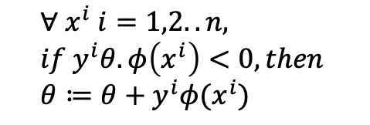
Data View
$$∀ x^{i} i=1,2..n, \\ if y^{i}θ.φ\left(x^{i}\right)<0, then \\ θ≔θ+y^{i}φ(x^{i})$$
Y | pred_1 | pred_2 | Name
1 | 3 | 2 | A
-1 | 6 | 7 | B
1 | 9 | 11 | C
B
A
C

Slide 4
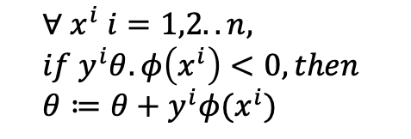
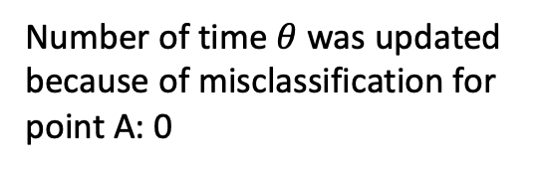
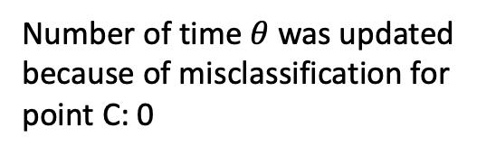
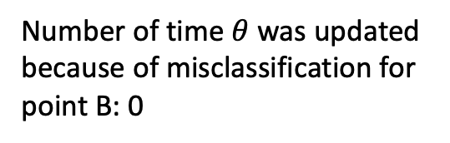
Algorithm Iterations: Iter1
$$∀ x^{i} i=1,2..n, \\ if y^{i}θ.φ\left(x^{i}\right)<0, then \\ θ≔θ+y^{i}φ(x^{i})$$
Y | pred_1 | pred_2 | Name
1 | 3 | 2 | A
-1 | 6 | 7 | B
1 | 9 | 11 | C
B
A
C
Number of time $θ$ was updated because of misclassification for point A: 0
Number of time $θ$ was updated because of misclassification for point B: 0
Number of time $θ$ was updated because of misclassification for point C: 0

Slide 5
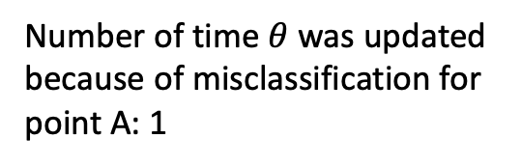
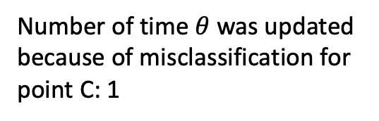
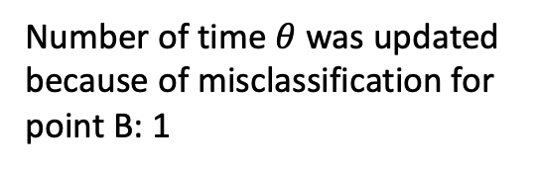
Algorithm Iterations: Iter2
$$∀ x^{i} i=1,2..n, \\ if y^{i}θ.φ\left(x^{i}\right)<0, then \\ θ≔θ+y^{i}φ(x^{i})$$
Y | pred_1 | pred_2 | Name
1 | 3 | 2 | A
-1 | 6 | 7 | B
1 | 9 | 11 | C
B
A
C
Number of time $θ$ was updated because of misclassification for point A: 1
Number of time $θ$ was updated because of misclassification for point B: 1
Number of time $θ$ was updated because of misclassification for point C: 1

Slide 6
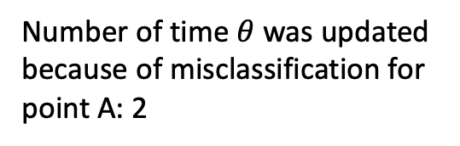
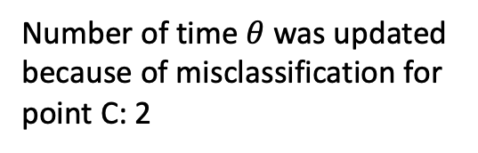
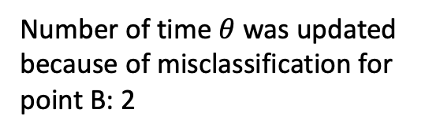
Algorithm Iterations: Iter3
$$∀ x^{i} i=1,2..n, \\ if y^{i}θ.φ\left(x^{i}\right)<0, then \\ θ≔θ+y^{i}φ(x^{i})$$
Y | pred_1 | pred_2 | Name
1 | 3 | 2 | A
-1 | 6 | 7 | B
1 | 9 | 11 | C
B
A
C
Number of time $θ$ was updated because of misclassification for point A: 2
Number of time $θ$ was updated because of misclassification for point B: 2
Number of time $θ$ was updated because of misclassification for point C: 2

Slide 7
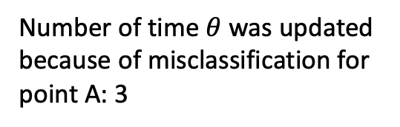
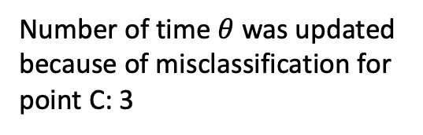
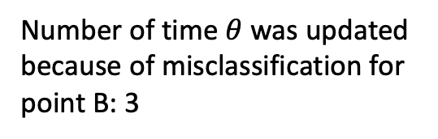
Algorithm Iterations: Iter4
$$∀ x^{i} i=1,2..n, \\ if y^{i}θ.φ\left(x^{i}\right)<0, then \\ θ≔θ+y^{i}φ(x^{i})$$
Y | pred_1 | pred_2 | Name
1 | 3 | 2 | A
-1 | 6 | 7 | B
1 | 9 | 11 | C
B
A
C
Number of time $θ$ was updated because of misclassification for point A: 3
Number of time $θ$ was updated because of misclassification for point B: 3
Number of time $θ$ was updated because of misclassification for point C: 3

Slide 8
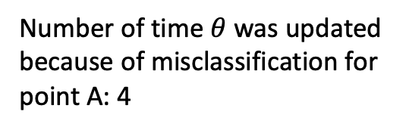
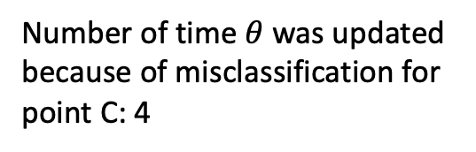
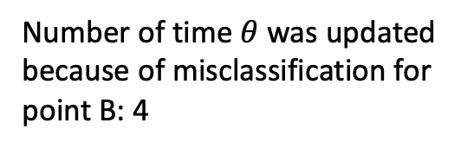
Algorithm Iterations: Iter5
$$∀ x^{i} i=1,2..n, \\ if y^{i}θ.φ\left(x^{i}\right)<0, then \\ θ≔θ+y^{i}φ(x^{i})$$
Y | pred_1 | pred_2 | Name
1 | 3 | 2 | A
-1 | 6 | 7 | B
1 | 9 | 11 | C
B
A
C
Number of time $θ$ was updated because of misclassification for point A: 4
Number of time $θ$ was updated because of misclassification for point B: 4
Number of time $θ$ was updated because of misclassification for point C: 4

Slide 9

Algorithm Iterations: Iter5
$$∀ x^{i} i=1,2..n, \\ if y^{i}θ.φ\left(x^{i}\right)<0, then \\ θ≔θ+y^{i}φ(x^{i})$$
Y | pred_1 | pred_2 | Name
1 | 3 | 2 | A
-1 | 6 | 7 | B
1 | 9 | 11 | C
B
A
C
Number of time $θ$ was updated because of misclassification for point A: 4
Number of time $θ$ was updated because of misclassification for point B: 4
Number of time $θ$ was updated because of misclassification for point C: 4
$$θ_{final}=∑α_{i}y_{i}φ(x_{i})$$

Slide 10
Algorithm Iterations: Final Formulation
$$∀ x^{i} i=1,2..n, \\ if y^{i}θ.φ\left(x^{i}\right)<0, then \\ θ≔θ+y^{i}φ(x^{i})$$
Y | pred_1 | pred_2 | Name
1 | 3 | 2 | A
-1 | 6 | 7 | B
1 | 9 | 11 | C
? | 5.5 | 6.5 | D
B
A
C
$$θ_{final}=∑α_{i}y_{i}φ(x_{i})$$

Slide 11

Algorithm Iterations: Final Formulation
$$∀ x^{i} i=1,2..n, \\ if y^{i}θ.φ\left(x^{i}\right)<0, then \\ θ≔θ+y^{i}φ(x^{i})$$
Y | pred_1 | pred_2 | Name
1 | 3 | 2 | A
-1 | 6 | 7 | B
1 | 9 | 11 | C
? | 5.5 | 6.5 | D
B
A
C
$$θ_{final}=∑α_{i}y_{i}φ(x_{i})$$
$$θ_{final}.{φ(x}_{d})$$

Slide 12

Algorithm Iterations: Final Formulation
$$∀ x^{i} i=1,2..n, \\ if y^{i}θ.φ\left(x^{i}\right)<0, then \\ θ≔θ+y^{i}φ(x^{i})$$
Y | pred_1 | pred_2 | Name
1 | 3 | 2 | A
-1 | 6 | 7 | B
1 | 9 | 11 | C
? | 5.5 | 6.5 | D
B
A
C
$$θ_{final}=∑α_{i}y_{i}φ(x_{i})$$
$${sign(θ}_{final}.{φ(x}_{d}))$$

Slide 13

Algorithm Iterations: Final Formulation
$$∀ x^{i} i=1,2..n, \\ if y^{i}θ.φ\left(x^{i}\right)<0, then \\ θ≔θ+y^{i}φ(x^{i})$$
Y | pred_1 | pred_2 | Name
1 | 3 | 2 | A
-1 | 6 | 7 | B
1 | 9 | 11 | C
? | 5.5 | 6.5 | D
B
A
C
$$θ_{final}=∑α_{i}y_{i}φ(x_{i})$$
$$sign(θ_{final}.{φ(x}_{d}))$$

Slide 14
Algorithm Iterations: Final Formulation
$$∀ x^{i} i=1,2..n, \\ if y^{i}θ.φ\left(x^{i}\right)<0, then \\ θ≔θ+y^{i}φ(x^{i})$$
Y | pred_1 | pred_2 | Name
1 | 3 | 2 | A
-1 | 6 | 7 | B
1 | 9 | 11 | C
? | 5.5 | 6.5 | D
B
A
C
$$θ_{final}=∑α_{i}y_{i}φ(x_{i})$$
$$sign\left(θ_{final}.{φ(x}_{d})\right)=sign(∑α_{i}y_{i}φ\left(x_{i}\right).φ\left(x_{d}\right))$$

Slide 15
Algorithm Iterations: Final Formulation
$$∀ x^{i} i=1,2..n, \\ if y^{i}θ.φ\left(x^{i}\right)<0, then \\ θ≔θ+y^{i}φ(x^{i})$$
Y | pred_1 | pred_2 | Name
1 | 3 | 2 | A
-1 | 6 | 7 | B
1 | 9 | 11 | C
? | 5.5 | 6.5 | D
B
A
C
$$θ_{final}=∑α_{i}y_{i}φ(x_{i})$$
$$sign\left(θ_{final}.{φ(x}_{d})\right)=sign(∑α_{i}y_{i}φ\left(x_{i}\right).φ\left(x_{d}\right))$$

Slide 16

Algorithm Iterations: Final Formulation
$$∀ x^{i} i=1,2..n, \\ if y^{i}θ.φ\left(x^{i}\right)<0, then \\ θ≔θ+y^{i}φ(x^{i})$$
Y | pred_1 | pred_2 | Name
1 | 3 | 2 | A
-1 | 6 | 7 | B
1 | 9 | 11 | C
? | 5.5 | 6.5 | D
B
A
C
$$θ_{final}=∑α_{i}y_{i}φ(x_{i})$$
$$K(x_{i},x_{d})$$
$$sign\left(θ_{final}.{φ(x}_{d})\right)=sign(∑α_{i}y_{i}φ\left(x_{i}\right).φ\left(x_{d}\right))$$

Slide 17
Matrix Factorization

Slide 18
Collaborative Filtering: Matrix Factorization
 | Star Trek | Avatar | Spiderman | Hulk
User 1 | 4 | 4 | 1 | 1
User 2 | 5 | 5 | 2 | 2
User 3 | 1 | 1 | 4 | 4
User 4 | 2 | 2 | 5 | 5

Slide 19
Collaborative Filtering: Matrix Factorization
 | Star Trek | Avatar | Spiderman | Hulk
User 1 | 4 | 4 | 1 | 1
User 2 | 5 | 5 | 2 | 2
User 3 | 1 | 1 | 4 | 4
User 4 | 2 | 2 | 5 | 5
User factor matrix

Slide 20
Collaborative Filtering: Matrix Factorization
 | Star Trek | Avatar | Spiderman | Hulk
User 1 | 4 | 4 | 1 | 1
User 2 | 5 | 5 | 2 | 2
User 3 | 1 | 1 | 4 | 4
User 4 | 2 | 2 | 5 | 5
User factor matrix
Item factor matrix

Slide 21
Collaborative Filtering: Matrix Factorization
 | Star Trek | Avatar | Spiderman | Hulk
User 1 | 4 | 4 | 1 | 1
User 2 | 5 | 5 | 2 | 2
User 3 | 1 | 1 | 4 | 4
User 4 | 2 | 2 | 5 | 5
Dim 1 | Dim 2
0.5 | -0.41
0.5 | -0.57
-0.5 | 0.41
-0.5 | 0.57

Slide 22
Collaborative Filtering: Matrix Factorization
 | Star Trek | Avatar | Spiderman | Hulk
User 1 | 4 | 4 | 1 | 1
User 2 | 5 | 5 | 2 | 2
User 3 | 1 | 1 | 4 | 4
User 4 | 2 | 2 | 5 | 5
Dim 1 | Dim 2
0.5 | -0.41
0.5 | -0.57
-0.5 | 0.41
-0.5 | 0.57
 | Star Trek | Avatar | Spiderman | Hulk
Dim 1 | 0.5 | 0.5 | -0.5 | -0.5
Dim 2 | -0.2 | -0.2 | 0.7 | 0.7

Slide 23
Collaborative Filtering: Matrix Factorization
 | Star Trek | Avatar | Spiderman | Hulk
User 1 | 4 | 4 | 1 | 1
User 2 | 5 | 5 | 2 | 2
User 3 | 1 | 1 | 4 | 4
User 4 | 2 | 2 | 5 | 5
Scifi | Dim 2
0.5 | -0.41
0.5 | -0.57
-0.5 | 0.41
-0.5 | 0.57
 | Star Trek | Avatar | Spiderman | Hulk
Scifi | 0.5 | 0.5 | -0.5 | -0.5
Dim 2 | -0.2 | -0.2 | 0.7 | 0.7

Slide 24
Collaborative Filtering: Matrix Factorization
 | Star Trek | Avatar | Spiderman | Hulk
User 1 | 4 | 4 | 1 | 1
User 2 | 5 | 5 | 2 | 2
User 3 | 1 | 1 | 4 | 4
User 4 | 2 | 2 | 5 | 5
Scifi | Fantasy
0.5 | -0.41
0.5 | -0.57
-0.5 | 0.41
-0.5 | 0.57
 | Star Trek | Avatar | Spiderman | Hulk
Scifi | 0.5 | 0.5 | -0.5 | -0.5
Fantasy | -0.2 | -0.2 | 0.7 | 0.7

Slide 25
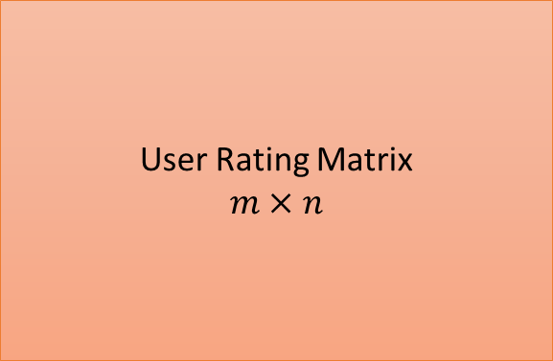
Collaborative Filtering: Matrix Factorization
User Rating Matrix
$$m×n$$

Slide 26
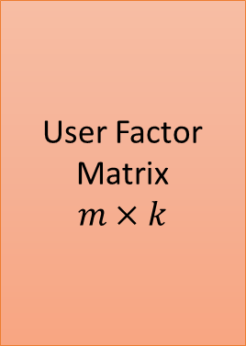


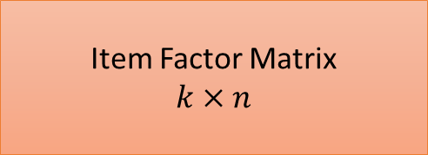
Collaborative Filtering: Matrix Factorization
User Rating Matrix
$$m×n$$
User Factor Matrix
$$m×k$$
Item Factor Matrix
$$k×n$$
$$v^{T}$$
$$u$$

Slide 27
Collaborative Filtering: Matrix Factorization
User Rating Matrix
$$m×n$$
User Factor Matrix
$$m×k$$
Item Factor Matrix
$$k×n$$
$$v^{T}$$
$$u$$
$$k<min⁡(m,n)$$

Slide 28
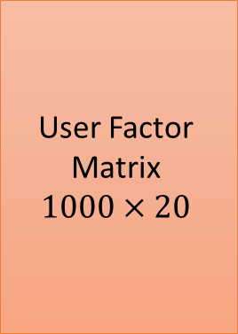
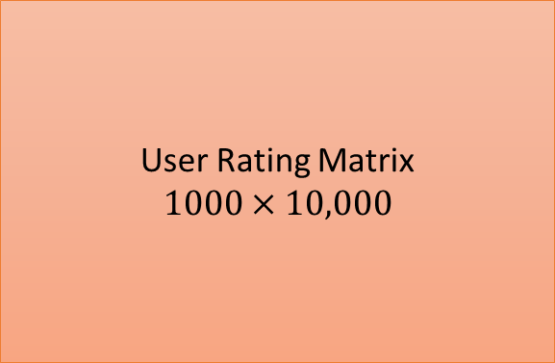

Collaborative Filtering: Matrix Factorization
User Rating Matrix
$$1000×10,000$$
User Factor Matrix
$$1000×20$$
Item Factor Matrix
$$20×10,000$$
$$v^{T}$$
$$u$$
$$20<min⁡(1000,10000)$$

